Slide 1
Transformation and Outlier

Slide 2
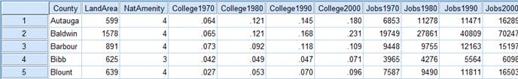
Data format transformation – Long vs wide data
The Wide Format : In the wide format, a subject’s repeated responses will be in a single row, and each response is in a separate column.
For example, in this data set, each county was measured at four time points, once every 10 years starting in 1970.
Notes:
Turning col names A,B & C into values of a new_var my_key using gather func
Use –col to include all col in the gather func except 1st col named COL.

Slide 3
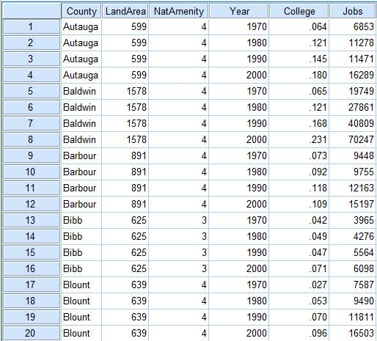
Data format transformation – Long vs wide data
The Long Format: In the long format, each row is one time point per subject. So each subject (county) will have data in multiple rows. Any variables that don’t change across time will have the same value in all the rows.
You can see the same five counties’ data below in the long format. Each county has four rows of data–one for each year.
Notes:
Turning col names A,B & C into values of a new_var my_key using gather func
Use –col to include all col in the gather func except 1st col named COL.

Slide 4
Univariate Analysis
Univariate Analysis:
Univariate analysis is the simplest form of analysing data. “Uni” means “one”, so in other words your data has only one variable. It doesn’t deal with causes or relationships (unlike regression) and it’s major purpose is to describe; it takes data, summarizes that data and finds patterns in the data.
Some ways you can describe patterns found in univariate data include central tendency (mean, mode and median) and dispersion: range, variance, maximum, minimum, quartiles (including the interquartile range), and standard deviation.
Source: http://www.statisticshowto.com

Slide 5
Univariate Analysis
Data Distribution:
Histogram
Skewness (left skewed, right skewed)
Treatment of skewness – log / sqrt transformation – Process of normalization.
Box plot
Quartiles (Q1, Q2, Q3)
Inter Quartile Range (IQR)
Identify percentage of outliers
Treatment of outliers
Bar chart
- Horizontal Bar Chart, Vertical Bar Chart
Pie chart
Percent composition of a variable

Slide 6
Resolving Skewness
Skewness is a measure of shape. A common approach to check for skewness is to plot the predictor variable.
As a rule, negative skewness indicates that the mean of the data values is less than the median, and the data distribution is left-skewed.
Positive skewness would indicates that the mean of the data values is larger than the median, and the data distribution is right-skewed.

Slide 7
Resolving Skewness
If the skewness of the predictor variable is 0, the data is perfectly symmetrical,
If the skewness of the predictor variable is less than -1 or greater than +1, the data is highly skewed,
If the skewness of the predictor variable is between -1 and -1/2 or between +1 and +1/2 then the data is moderately skewed,
If the skewness of the predictor variable is -1/2 and +1/2, the data is approximately symmetric.

Slide 8
How Skewness impact our data model?
Impact on sampling on categorical variable:
If the categorical data is skewed, random sampling will be a bad choice.
Stratified-Random-Sampling will make sense.

Slide 9
How Skewness impact our data model?
Impact on numerical variable:
Lets assume a linear regression model, build with a dependable variable which is skewed. For your coefficients to be interpretable, linear regression assumes a bunch of things.
One of these things is no multicollinearity. That is, your X variables should not be correlated against each other.
Another is Homoscedasticity. The errors your model commits should have the same variance, i.e. you should ensure the linear regression does not make small errors for low values of X and big errors for higher values of X. In other words, the difference between what you predict Y and the true values Y should be constant. You can ensure that by making sure that Y follows a Gaussian distribution. (The proof is highly mathematical.)

Slide 10
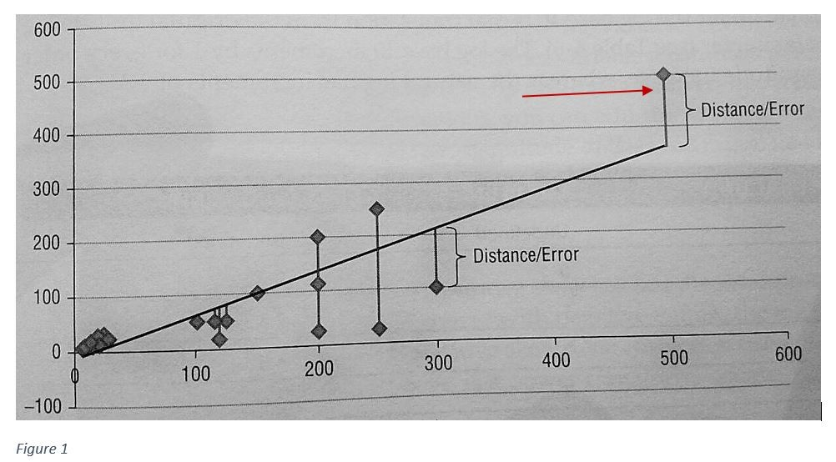
How Skewness impact our data model?
Impact on numerical variable:

Slide 11
How Skewness impact our data model?
Impact on hypothesis test:
Parametric test link ANOVA can not be applied to skewed data.

Slide 12
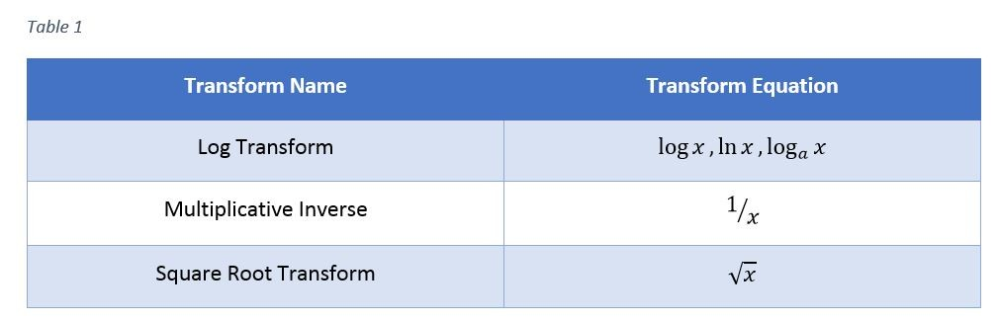
Treatment of skewness – Process of normalization.
For Positive Skewness use:
For Negative Skewness use:
Negative skew is less common than positive skew but has the same problems with bias that positive skew has. One correction used often to transform negatively skewed variables is a power transform: square, cube, or raise the variable to a higher power.
If the variable has a large magnitude, raising that value to a higher power will create very large transformed values and even cause numeric overflow. It is therefore advisable to scale the variable first by its magnitude before raising it to a higher power.

Slide 13
Resolving Outliers
An outlier is a data point that differs greatly from other values in a data set. Outliers are important to keep in mind when looking at pools of data because they can sometimes affect how the data is perceived on the whole.
Outliers in data can distort predictions and affect the accuracy, if you don’t detect and handle them appropriately especially in regression models.

Slide 14
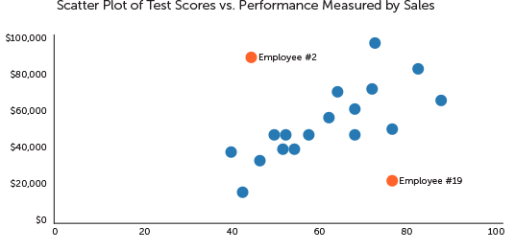
Resolving Outliers
Employee # | Test Score (out of 100) | Monthly Sales
1 | 71 | $69,243
2 | 34 | $67,445
3 | 84 | $55,767
4 | 71 | $50,240
5 | 61 | $46,772
6 | 5 | $41,389
7 | 92 | $40,102
8 | 65 | $37,655
9 | 45 | $34,241
10 | 74 | $31,498
11 | 53 | $31,400
12 | 65 | $30,084
13 | 45 | $29,751
14 | 50 | $27,782
15 | 41 | $26,997
16 | 45 | $24,408
17 | 29 | $21,126
18 | 38 | $18,665
19 | 78 | $12,505
20 | 34 | $9,449

Slide 15
Resolving Outliers
Imputation and Capping
Dangerous Game

Slide 16
Data transformation – Centering and Scaling
Many researchers have noted the importance of standardizing variables for multivariate analysis. Otherwise, variables measured at different scales do not contribute equally to the analysis.
For example, in boundary detection, a variable that ranges between 0 and 100 will outweigh a variable that ranges between 0 and 1. Using these variables without standardization in effect gives the variable with the larger range a weight of 100 in the analysis.
Transforming the data to comparable scales can prevent this problem. Typical data standardization procedures equalize the range and/or data variability.

Slide 17
Centering and Scaling
Centering: Variable centering is perhaps the most intuitive approach used in predictive modeling. To center a predictor variable, the average predictor value is subtracted from all the values. as a result of centering, the predictor has zero mean.
To scale the data, each predictor value is divided by its standard deviation (SD). This helps in coercing the predictor value to have a SD of one.
Needless to mention, centering and scaling will work for continuous data.

Slide 18
Centering and Scaling – Standardizing data (Z – Score)
Using the scale function
Perhaps the most simple, quick and direct way to mean-center your data is by using the function scale(). By default, this function will standardize the data (mean zero, unit variance). To indicate that we just want to subtract the mean, we need to turn off the argument scale = FALSE.
Using the apply function
Center can be done with the apply() function. In this case, the idea is to remove the mean on each column. This is done by declaring a function (inside apply()) that performs the mean-centering operation:

